Slide 1
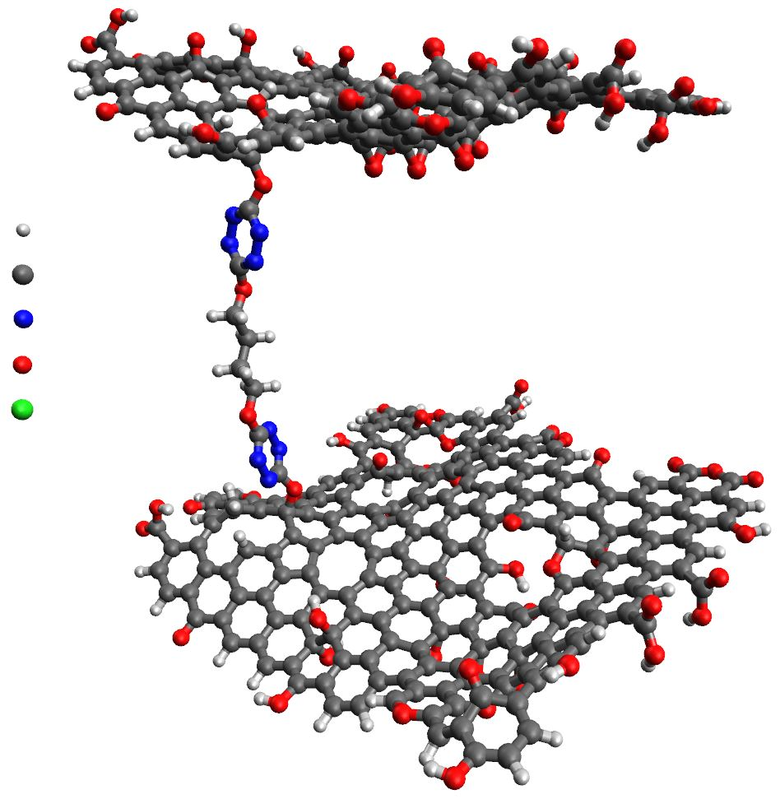

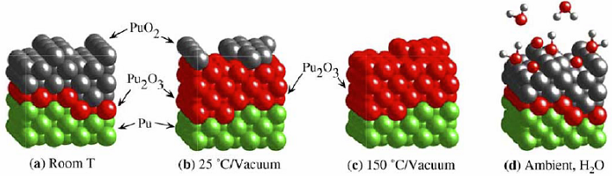
第一性原理计算模拟的发展和应用
张萃
松山湖材料实验室，东莞
2019 年 7 月 23 日

Slide 2

— Outline —
01
Introduction of First-principles Calculations
02
Density Functional Theory Framework
03
First-principles Molecular Dynamics
04
Examples

Slide 3
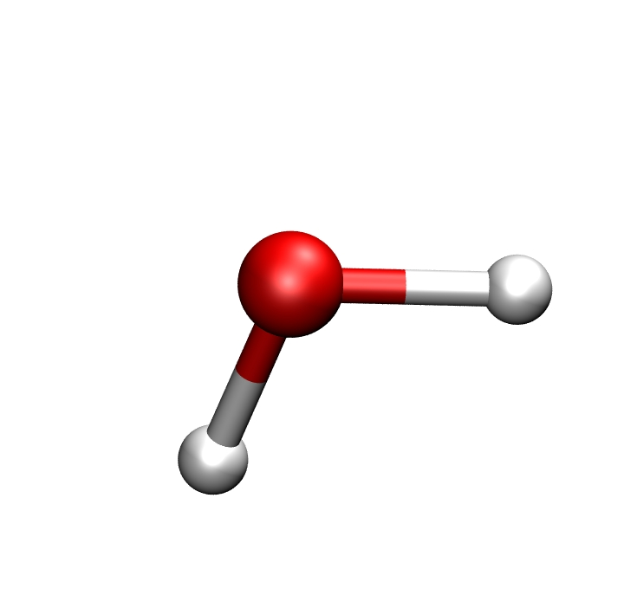
First-principles Simulations
Simulations of Real Materials Based on Quantum Mechanics
Erwin Schrödinger
Max Born
Julius R. Oppenheimer
Supercomputers
Increased Complexity of Material System

Slide 4
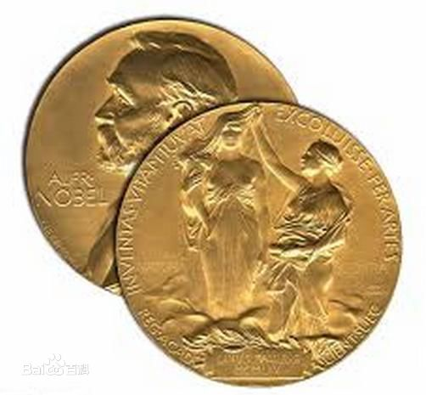
First-principles Simulations
Simulations of Real Materials Based on Quantum Mechanics
Electronic Structure
Density Functional Theory
Wave Function Method
Quantum Monte Carlo
1998 Nobel Prize in Chemistry
Walter Kohn (DFT)
John A. Pople (Quantum chemistry methods)
Simulation of Atomic Nuclei in Materials Based on Electronic Structure
2013 Nobel Prize in Chemistry
Martin Karplus
Michael Levitt
Arieh Warshel
Molecular Dynamics
Structure Prediction
Quantum-Classical Hybridization Method
Multiscale models for complex chemical systems

Slide 5
First-principles Simulations
Simulations of Real Materials Based on Quantum Mechanics
Application
SC, PEC
Simulation
surface, low-dimension…
Method Development
strong correlation, electron-phone coupling…
Simulation
Experiment
Theory
Foundation
Law
Phenomena
Model
Data
Theory Test
Basis
Feasibility
Explanation
Prediction
Phenomena
Model

Slide 6
How to make impact?
Methods:
DFT, potentials,
MD, MC,
Coarse-graining etc
Knowledge: What to compute?
Basic properties of matter
Reaction mechanisms
Functional processes etc
Materials
Problem
Tools
People
Dissemination:
Publication,
Code development etc
Education: Computational
Materials science
Chemistry etc

Slide 7
Theory of Properties
Multi-scale Material View
Continuum
Properties
Microstructure
Atoms
Electrons

Slide 8

Theory of Properties
Multi-scale Material View
Continuum
Properties
Microstructure
Atoms
Electrons
Calculated
quantities
(ab initio)
Learning Methods
Neural network
Correlation method
…
Macroscopic
output

Slide 9

Theory of Properties
Three Main Goals
Ensemble average (thermodynamics)
Real-time evolution (dynamics)
Ground/excited states of complex structure
Structure: liquids, glasses, solids, defects, surfaces, interfaces
Bond-breaking, charge transfer

Slide 10

Energy Models
Energy models are important because it is representation of the structure, material properties and chemical process.
Empirical Models: functional forms with parameters fitted to experimental data (or calculated data)
Pair potentials
Many-body potentials
Effective medium theories
Energy only E$(R)$
Increased Speed
Increased transferability
Which one is the best?
Semi-Empirical Models:
Tight binding
MINDO
Energy and electronic structure
Quantum mechanical: start from Schrodinger equation and make approximations
Hartree Fork Approximations
Density Functional Theory
Quantum Monte Carlo
Notes:
Modified Intermediate Neglect of Differential Overlap，

Slide 11
— Outline —
01
Introduction of First-principles Calculations
02
Density Functional Theory Framework
03
First-principles Molecular Dynamics
04
Examples

Slide 12

Microscopic Description of Atoms
Physical Model:
Electrons + Nucleus
Math Description:
Schrödinger Equation:
Electron
Nucleus
Kinetic energy
Kinetic energy
Coulomb interaction
Coulomb interaction
Electron-nucleus coupling

Slide 13
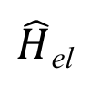
Born-Oppenheimer approximation
“Adiabatic approximation”
Separate electronic and nuclear motions
Only include electrons as quantum particles
$\hat{H}$_{el}
❌
❌
Many-body problem
A function of nuclear geometry
Electronic Structure

Slide 14
Hartree-Fork Approximations
Slater Determinant of many-particle wave function:
Limitation: lacking electron correlation
Post HF methods: more elaborate approximation for many-body wave function
Configuration Interaction (CI) method
Moller-Plesset (MP) perturbation theory
Couple-Cluster(CC) method
Can be very accurate, But, …scaling

Slide 15

Doubling every 18 months
30 years
10⁶ increase in performance
Hartree-Fork Approximations: Scaling
What does more computing buy us ?
Method | Today (electrons) | 30 years
HF + CI (N⁶) | 10 | 100
Potentials | 10⁸ | 10¹⁴
DFT (N³) | 1000 | 100,000
Atoms
Small molecules
Molecules
Condensed matter

Slide 16
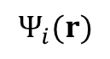
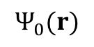
Density Functional Theory: HK Theorems
Hohenberg-Kohn Theorem I:
External potential V_{ext} (r) is determined uniquely by the ground state particle density n₀(r).
Hohenberg-Kohn Theorem II:
For any given V_{ext} (r), the exact ground state energy is the global minimum of E[n(r)], and the density n(r) minimizing E[n(r)] is the exact ground state density n₀(r).
HK
V_{ext} (r)
n₀(r)
n₀(r)
$$Ψ_{i}(r)$$
$$Ψ_{0}(r)$$
Exact theory of many-body systems

Slide 17
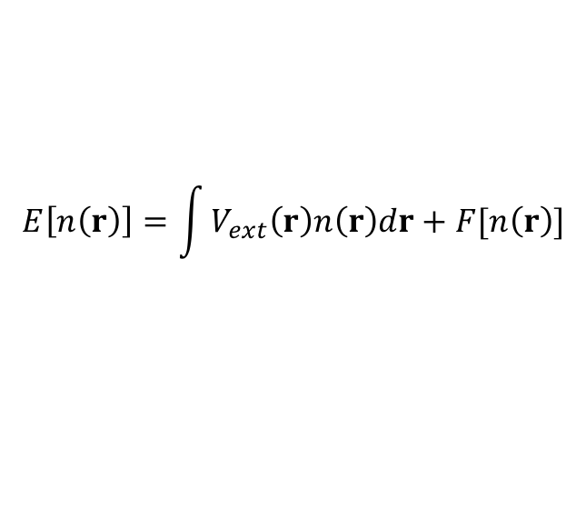
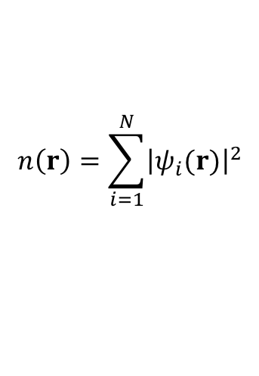
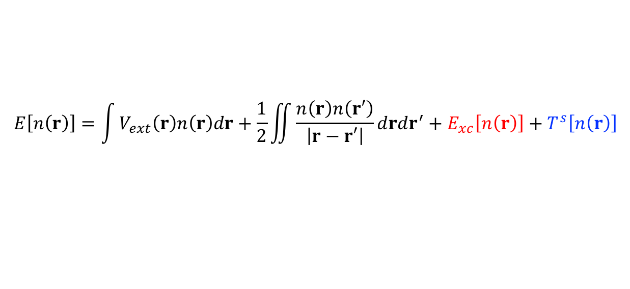
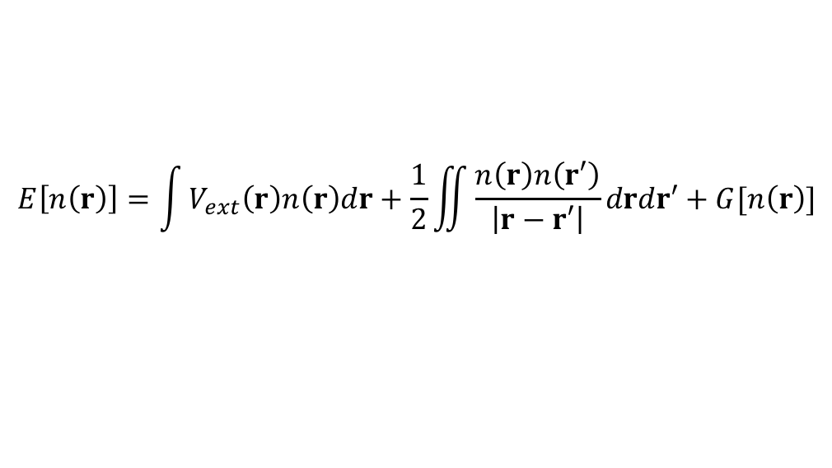
Density Functional Theory: KS Scheme
Kohn-Sham scheme: A practical scheme
$$E\left[n\left(r\right)\right]=\int{V_{ext}\left(r\right)n\left(r\right)dr}+F[n\left(r\right)]$$
$$n\left(r\right)=\sum_{i=1}^{N}{{\left|ψ_{i}(r)\right|}^{2}}$$
(HK Theorem I)
$$E\left[n\left(r\right)\right]=\int{V_{ext}\left(r\right)n\left(r\right)dr}+\frac{1}{2}\iint{\frac{n\left(r\right)n\left(r′\right)}{\left|r−r′\right|}}drdr′+G[n\left(r\right)]$$
Hartree energy
Unknown universal functional
$$E\left[n\left(r\right)\right]=\int{V_{ext}\left(r\right)n\left(r\right)dr}+\frac{1}{2}\iint{\frac{n\left(r\right)n\left(r′\right)}{\left|r−r′\right|}}drdr^{′}+E_{xc}\left[n\left(r\right)\right]+T^{s}\left[n\left(r\right)\right]$$
Exchange-correlation
term
Kinetic energy
Non-interacting system
KS scheme maps the complex, interacting electronic systems into a non-interacting systems, moving in an effective local potential.

Slide 18
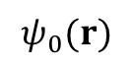
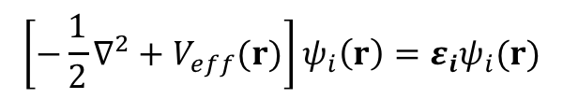
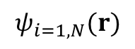
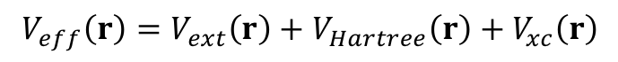
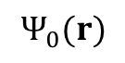
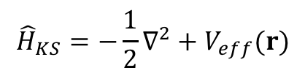
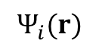
Density Functional Theory: KS Scheme
Kohn-Sham Hamiltonian of independent-particle system:
$${\hat{H}}_{KS}=−\frac{1}{2}∇^{2}+V_{eff}(r)$$
$$V_{eff}\left(r\right)=V_{ext}\left(r\right)+V_{Hartree}\left(r\right)+V_{xc}\left(r\right)$$
$${\left[−\frac{1}{2}∇^{2}+V_{eff}(r)\right]ψ}_{i}\left(r\right)=ε_{i}ψ_{i}(r)$$
Kohn-Sham Equation:
Two assumptions: “System of non-interacting particles” and “$V_{eff}\left(r\right)$”
HK
HK
V_{ext} (r)
n₀(r)
V_{eff} (r)
n₀(r)
KS
n₀(r)
n₀(r)
$$Ψ_{i}(r)$$
$$Ψ_{0}(r)$$
$$ψ_{i=1,N}(r)$$
$$ψ_{0}(r)$$

Slide 19
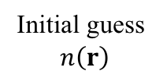
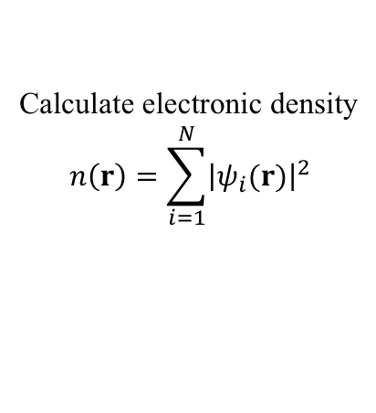
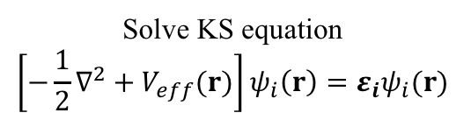
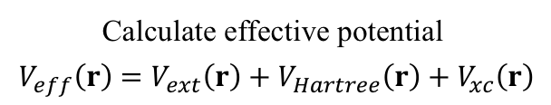
Flowchart of Solving KS Equation
Initial guess
$$n\left(r\right)$$
Calculate effective potential
$V_{eff}\left(r\right)$ $=V_{ext}\left(r\right)+V_{Hartree}\left(r\right)+V_{xc}\left(r\right)$
Solve KS equation
$${\left[−\frac{1}{2}∇^{2}+V_{eff}(r)\right]ψ}_{i}\left(r\right)=ε_{i}ψ_{i}(r)$$
Calculate electronic density
$$n\left(r\right)=\sum_{i=1}^{N}{{\left|ψ_{i}(r)\right|}^{2}}$$
No
Self-consistent?
Yes
Output: energy, forces, eigenvalues…

Slide 20
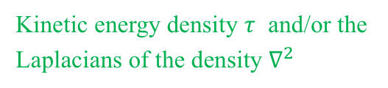
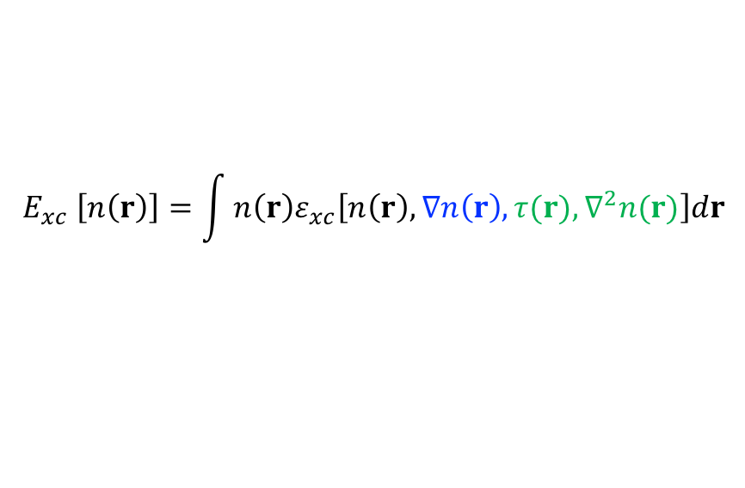
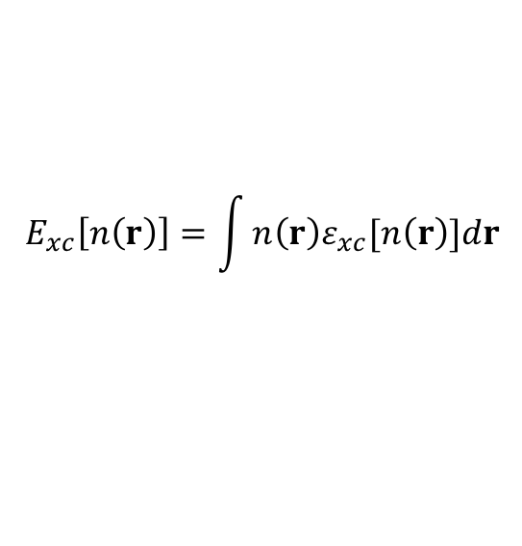
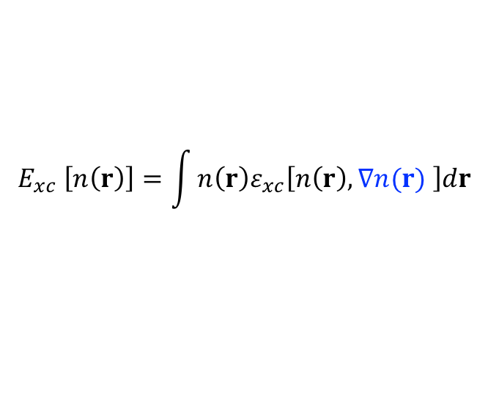
Exchange and Correlation Functional
In KS scheme, all the many-body interaction complexity is put into exchange-correlation energy $E_{xc}\left[n\left(r\right)\right]$.
Exact expression is unknown, approximation is required!
Local density approximation (LDA)
$$E_{xc}\left[n\left(r\right)\right]=\int{n\left(r\right)ε_{xc}[n\left(r\right)]dr}$$
Homogeneous electron gas
Generalized gradient approximation (GGA)
(PBE, PW, BLYP….)
$$E_{xc} \left[n\left(r\right)\right]=\int{n\left(r\right)ε_{xc}\left[n\left(r\right),∇n(r) \right]dr}$$
Gradient of the density
Meta-GGA
(SCAN）
$$E_{xc} \left[n\left(r\right)\right]=\int{n\left(r\right)ε_{xc}\left[n\left(r\right),∇n\left(r\right),τ(r),∇^{2}n(r)\right]dr}$$
Kinetic energy density $τ$ and/or the Laplacians of the density $∇^{2}$

Slide 21
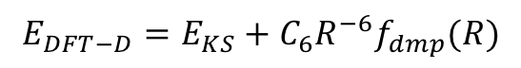
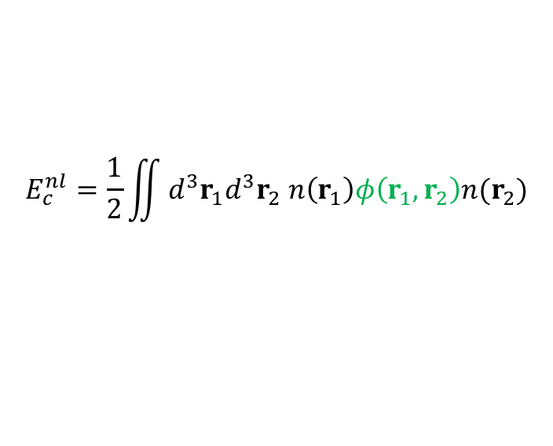
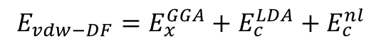
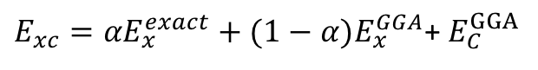
Exchange and Correlation Functional
vdW density functional
Dispersion corrections
(vdW-DF2, optPBE-vdW, optB88-vdW)
$$E_{vdw−DF}=E_{x}^{GGA}+E_{c}^{LDA}+E_{c}^{nl}$$
$$E_{c}^{nl}=\frac{1}{2}\iint{d^{3}r_{1}d^{3}r_{2} n\left(r_{1}\right)φ\left(r_{1},r_{2}\right)n(r_{2})}$$
DFT-D
$$E_{DFT−D}=E_{KS}+C_{6}R^{−6}f_{dmp}(R)$$
(TS, DFT-D2)
Hybrid density functional
Exact exchange
$E_{xc}={αE}_{x}^{exact}+(1−α)E_{x}^{GGA}$+ $E_{C}^{GGA}$
(PBE0)
Three-parameter hybrid functional (B3LYP)
Screened hybrid functional (HSE)

Slide 22


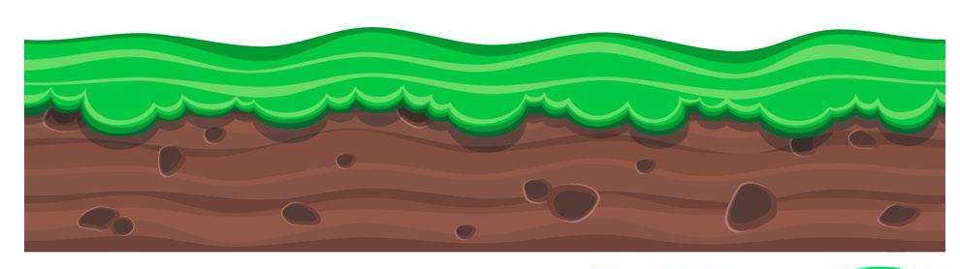
Jacob’s Ladder
Chemical Accuracy
?
Unoccupied orbital info
Hybrid
Explicit occupied orbital info
mGGA
Inexplicit occupied orbital info
GGA
Density gradient
LDA
Local density
Hartree Theory

Slide 23
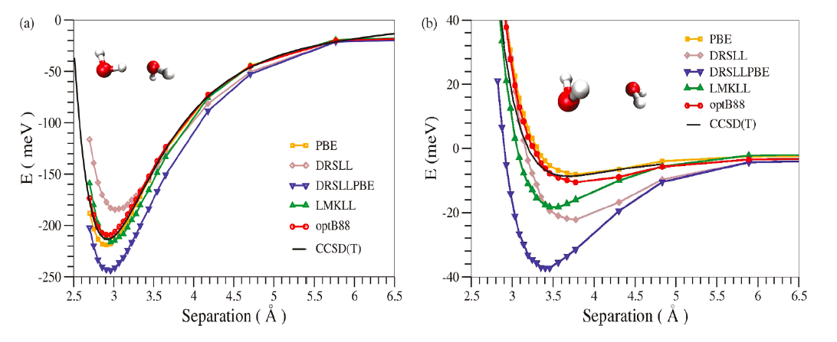
Water Dimer Interactions
Relative free energies of H-bonded and non-H-bonded configurations samples during diffusion are not very accurate: different errors for most functionals.
Formidable task to describe, at the same level of accuracy, many different types of interactions: covalent bonding, hydrogen bonding, vdW interactions.

Slide 24
Pseudopotentials
Core electrons + Valence electrons
Core electrons can be replaced by an angular dependent pseudopotentials.
R_{c}
Si: 1s² 2s² 2p⁶ 3s² 3p²
valence electron # = 4
Ti: 1s² 2s² 2p⁶ 3s² 3p⁶ 3d² 4s²
valence electron # = 10

Slide 25
Pseudopotentials
“Norm-conserving (NC)”:
Integral of core region charge density = All-electron one
High accuracy, high transferability
Large cut-off radius of PW basis set
“Ultra-soft (US)”: Smooth wave function in the core region, but not accurate in there
Small cut-off radius of PW basis set
“Projector augmented wave (PAW) method”: All-electron + pseudopotential methods
Augmentation sphere + Interstitial region
All-electron spherical augmentation function
Pseudo wave function

Slide 26
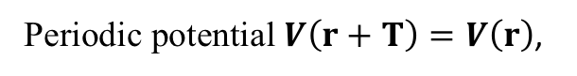
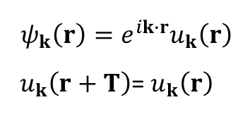
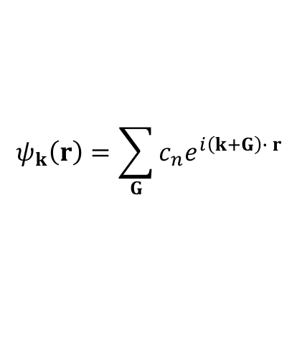
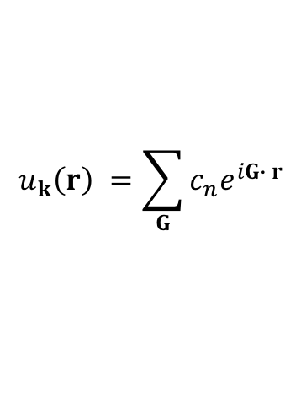
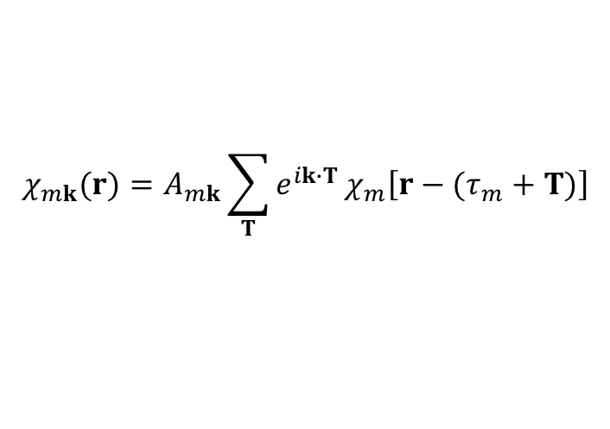
Basis Sets
Plane waves:
Bloch Theorem:
Periodic potential $V\left(r+T\right)=V\left(r\right)$,
T lattice vector
G reciprocal lattice vector
$$ψ_{k}\left(r\right)=e^{ik∙r}u_{k}\left(r\right)$$
${ u}_{k}\left(r+T\right)$= $u_{k}\left(r\right)$
$$u_{k}\left(r\right) =\sum_{G}{c_{n}e^{iG∙ r}}$$
$$ψ_{k}\left(r\right)=\sum_{G}{c_{n}e^{i\left(k+G\right)∙ r}}$$
Cut-off radius
$$χ_{mk}(r)=A_{mk}\sum_{T}{e^{ik∙T}}χ_{m}\left[r−(τ_{m}+T)\right]$$
Localized orbitals:
Scaling “ order- N ”
Linear combination of atomic orbitals (LCAO)
Size: number of orbitals per atom
single-$ζ$ to multiple- $ζ$ with polarization and diffuse orbitals

Slide 27
— Outline —
01
Introduction of First-principles Calculations
02
Density Functional Theory Framework
03
First-principles Molecular Dynamics
04
Examples

Slide 28
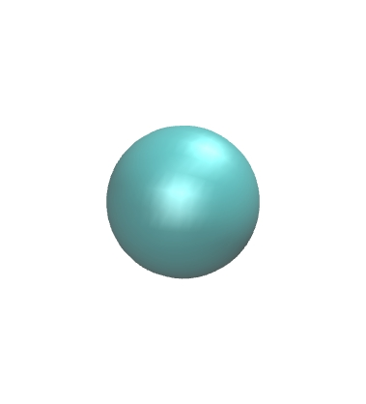
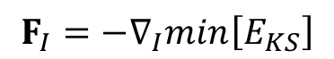
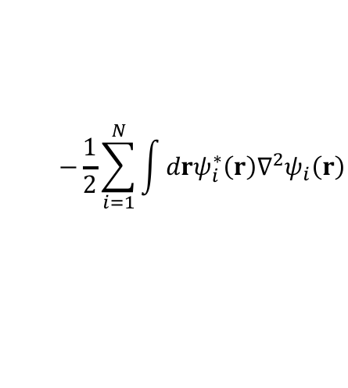
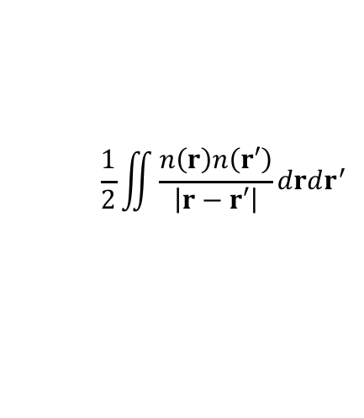
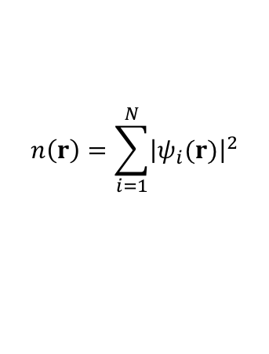
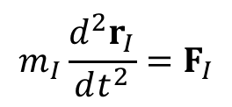
First-principles Molecular Dynamics
Within the density functional theory (DFT) framework, forces in FPMD are derived from Kohn-Sham Energy:
$$E_{KS}\left[n\left(r\right)\right]=E_{KE}+E_{Hartree}+E_{xc}+E_{ext}$$
$$n\left(r\right)=\sum_{i=1}^{N}{{\left|ψ_{i}(r)\right|}^{2}}$$
$$−\frac{1}{2}\sum_{i=1}^{N}{\int{drψ_{i}^{∗}\left(r\right)∇^{2}ψ_{i}\left(r\right)}}$$
$$\frac{1}{2}\iint{\frac{n\left(r\right)n\left(r′\right)}{\left|r−r′\right|}}drdr^{′}$$
Born-Oppenheimer MD
Energy
$$F_{I}=−∇_{I}min\left[E_{KS}\right]$$
Newton’s equation:
$${m_{I}\frac{d^{2}r_{I}}{dt^{2}}=F}_{I}$$
Time
“Ab initio”

Slide 29
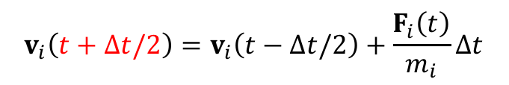
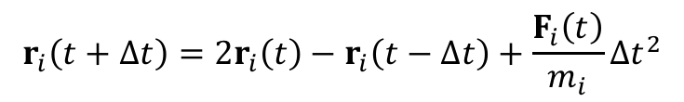
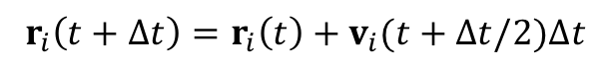
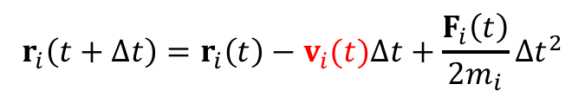
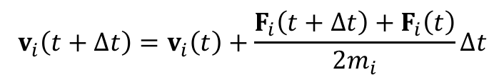
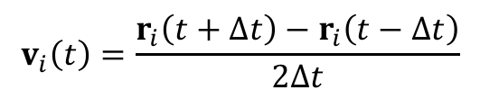
Algorithm
$$r_{i}\left(t+∆t\right)=2r_{i}\left(t\right)−r_{i}\left(t−∆t\right)+\frac{F_{i}\left(t\right)}{m_{i}}∆t^{2}$$
The Verlet Algorithm:
$$v_{i}\left(t\right)=\frac{r_{i}\left(t+∆t\right)−r_{i}\left(t−∆t\right)}{2∆t}$$
$$r_{i}\left(t+∆t\right)=r_{i}\left(t\right)−v_{i}(t)∆t+\frac{F_{i}\left(t\right)}{{2m}_{i}}∆t^{2}$$
The Velocity Verlet Algorithm:
$$v_{i}\left(t+∆t\right)=v_{i}\left(t\right)+\frac{F_{i}\left(t+∆t\right)+F_{i}\left(t\right)}{2m_{i}}∆t$$
$$v_{i}\left(t+∆t/2\right)=v_{i}\left(t−∆t/2\right)+\frac{F_{i}\left(t\right)}{m_{i}}∆t$$
The Leap Frog Algorithm:
velocities updated at half time step
$$r_{i}\left(t+∆t\right)=r_{i}\left(t\right)+v_{i}(t+∆t/2)∆t$$

Slide 30
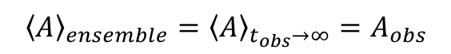

Ensembles
Ergodic hypothesis:
$${\left\langle A\right\rangle }_{ensemble}={\left\langle A\right\rangle }_{t_{obs}→∞}=A_{obs}$$
$$\frac{\int{Ae^{−βE}drdp}}{\int{e^{−βE}drdp}} ⟺ \lim_{t_{obs}→∞}{\frac{1}{t_{obs}}\int_{0}^{t_{obs}}{A\left(t\right)dt}}$$
Micro-canonical ensemble (NVE): isolated closed system
at thermodynamic equilibrium
Canonical ensemble (NVT): closed system in contact with heat bath
NVE
Nose-Hoover chain
Andersen thermostat
Langevin thermostat
…
Bath E_{B}
System E_{c}
NVT

Slide 31


Periodic Boundary Conditions (PBCs)
Condensed matter (10²³ particles)
MD supercell (100 ~10⁶ particles)
MD supercell + PBCs $→$ macroscopic system
Short range potential cutoff: r_{cut} < L/2
Long rang potential: Ewald summation
Reaction field method
Minimum Image Convention
Suitable for thermodynamic and structural properties, dynamic process
Not suitable for phase transition discussion

Slide 32


First-principles Molecular Dynamics
Limitation
Time scales
Length scale (PBCs help)
Accuracy
Classical nuclei
$→$ Jacobi’s ladder
$→$ Path-integral MD

Slide 33
— Outline —
01
Introduction of First-principles Calculations
02
Density Functional Theory Framework
03
First-principles Molecular Dynamics
04
Examples

Slide 34

1. Liquid Structure from First Principles
Multi-level simulations of water structure, IR spectra and entropy
Exp vs. vdW
Exp vs. vdW
Exp vs. GGA / hybrid
Exp vs. GGA / hybrid

Slide 35






2. Aqueous Environments from First Principles
Multi-level simulations on the band edge alignment:
Vacuum level
CBM
Reduction potential
Oxidation potential
VBM
H₂O/VBM

Slide 36







3. Water Under Confinement
Bulk water ρ=0.99 g/cm³
Bulk water ρ=0.90 g/cm³
GROMACS 4.5
SPC/E potential
N = 3456 - 221184
NVT ensemble
Particle Mesh Ewald
20-80 ns
L. Fumagalli et al. Science 360, 1339 (2018)

Slide 37







4. Actinide Surface Corrosion
Moisture-enhanced corrosion
PuO₂
Pu₂O₃
Pu
Dynamics
Thermodynamics
Cluster formation
Electronic structure
First principles calculations

Slide 38






5. High Pressure Solid Hydrogen
Science, 2017, 355(6326): 715-718.
Layer B
Layer A
Layer G
Notes:
Hexagonal close-packed

Slide 39
Conclusion
Computational modeling is very powerful, but
Be Smart !

Slide 40
Software
QUANTUM ESPRESSO (http://www.pwscf.org) (free) (DFT, planewave, ultrasoft, norm-conserving)
SIESTA (https://departments.icmab.es/leem/siesta/) ) (free) (DFT, localized basis set, norm-conserving)
ABINIT (http://www.abinit.org) (free) (DFT, planewave)
CPMD (http://www.cpmd.org) (free) (DFT, planewave, time-dependent DFT)
VASP (http://cms.mpi.univie.ac.at/vasp) ($) (DFT, planewave, ultrasoft, PAW)
Materials Studio/Cerius (http://www.accelrys.com) ($) (DFT, planewave, ultrasoft)
Crystal (http://www.chimifm.unito.it/teorica/crystal) ($) (Hartree-Fock)
Gaussian (http://www.gaussian.com) ($) (chemistry, Hartree-Fock, DFT, correlated approaches)
Gamess-UK (http://www.cse.clrc.ac.uk/qcg/gamess-uk/) ($) (chemistry, Hartree-Fock, DFT, correlated approaches)

Slide 41
Bibliography
Allen and Tildesley, “Computer Simulations of Liquid” (Oxford)
Frenkel and Smit, “Understanding Molecular Simulations” (Academic)
R. M. Martin, “Electronic Structure - Basics Theory and Practical Methods”
W. Koch, M. C. Holthausen, “A Chemist’s Guide to Density Functional Theory”
P. G. Parr, W. Yang, “Density Functional Theory of Atoms and Molecules”
K. Burke, “The ABC of DFT”
F. Jensen, “Introduction to Computational Chemistry”
J. M. Thijssen, “Computational Physics”
D. Chandler, “Introduction to Modern Statistical Mechanics”
D. A. McQuarrie, “Statistical Thermodynamics” OR “Statistical Mechanics”
M. E. J. Newman and G.T. Barkema, “Monte Carlo Methods in Statistical Physics”
K. Binder and D.W. Heerman, “Monte Carlo Simulation in Statistical Physics”

Slide 42





















